Slide 1


Department of Computer Science
University Institute of Engineering
DEPARTMENT OF COMPUTER SCIENCE & ENGINEERING
Bachelor of Engineering
Subject Name: System Programming
Subject Code: CST-281
Compilers
DISCOVER . LEARN . EMPOWER

Slide 2
Chapter-2.2 Scanning & parsing
Department of computer Science
Language Processor Development tools

Slide 3
Language Processor Development Tools
LPDT that is Language processor development tools focuses upon generation of the analysis phase of language processors. The Language processor development tools require the following inputs:
1. Requirement of a grammar of language L
2. Requirement of semantic actions to be performed into the analysis phase.
This generates programs which perform lexical, syntax and semantic analysis of the source program and then construct the IR. Such programs collectively by the analysis phase of the language processor.

Slide 4
Language Processor Development Tools
Writing of language processors is a well understood and repetitive process which ideally suits the program generation approach to software development.
Set of language processor development tools (LPDTs) focusing on generation of the analysis phase of language processors.

Slide 5
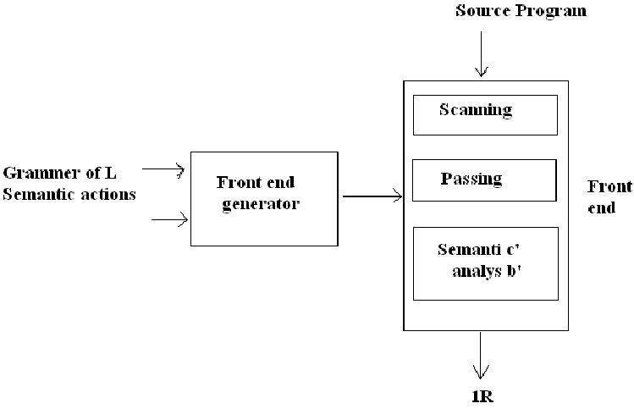
LPDT

Slide 6
LPDT
It generates programs that perform lexical, syntax and semantic analysis of the source program and construct the IR.
These programs collectively form the analysis phase of the language processor.
Lexical analyzer generator LEX, and the parser generator YACC.
Input to those tools is a specification of the lexical and syntactic constructs of L, and the semantic actions to be performed on recognizing the constructs.

Slide 7
LPDT
The Specification consists of a set of “Translation Rules” of the form
< string specification > { < semantic action > }
where, < semantic action > consist of C code.
The code is executed when a string matching < string specification > is encountered in the input.
LEX and YACC generate C programs which contain the code for scanning and parsing, respectively and the semantic actions contained in the specification.
A YACC generated parser can use a LEX generated scanner as a routine if the scanner and parser use same conventions concerning the representation of tokens.
A single pass compiler can be built using LEX and YACC if the semantic actions are aimed at generating target code instead of IR.
Note that scanner also generates an intermediate representation of a source program for use by the parser, we call it IRl to differentiate it from the IR of the analysis phase.

Slide 8
Examples
LEX
YACC

Slide 9
References
Department of computer Science
[PDF] Systems Programming and Operating Systems by Dhamdhere - Free Download PDF (dlscrib.com)
[PDF] Principles of Compiler Design By Alfred V. Aho & J.D.Ullman Free Download – Learnengineering.in
https://holub.com/goodies/compiler/compilerDesignInC.pdf

Slide 10

THANK YOU

